Slide 1


Detection of Alzheimer's Disease Using Deep Learning Algorithm (CNN)
DEPARTMENT OF COMPUTER SCIENCE AND ENGINEERING
COMPUTER SCİENCE
MS.C Student:
Mais Alhamidi

Slide 2
INTRODUCTION
Alzheimer's disease is a common brain disorder that affects many older people. Detecting it early is important for treatment. Deep learning algorithms, like CNN, have shown promise in using MRI scans to diagnose Alzheimer's. This tests show well CNN can detect Alzheimer's using MRI images. By using a large dataset of MRI scans from Alzheimer's patients and healthy people to train and evaluate the models. The goal is to improve the diagnosis and management of Alzheimer's disease.
What is Alzheimer

Slide 3
RESEARCH OBJECTIVE
To develop a predictive model using transfer learning algorithms for early detection and prediction of Alzheimer's disease.
Identify and analyze the potential of transfer learning algorithms in the field of Alzheimer's disease prediction.
Explore the effectiveness of transfer learning in extracting features from medical imaging data for accurate prediction of Alzheimer's disease and provide a comparative analysis and validation of experimental transfer learning models.

Slide 4
PROPOSED ARCHITECTURE
DATA COLLECCTION and PREPROCESSING
Image augmentation techniques and resize the images into (176x176)
OVERSAMPLING
Since the class labels are imbalanced, we used SMOTE oversampling technique to balance the dataset
TRAINING MODELS
Trained end-to-end, using the images as the target and minimizing the difference between the predicted and ground-truth captions.
PERFORMANCE EVALUATION
Accuracy, Precision, Recall, F1 score, Confusion matrix

Slide 5
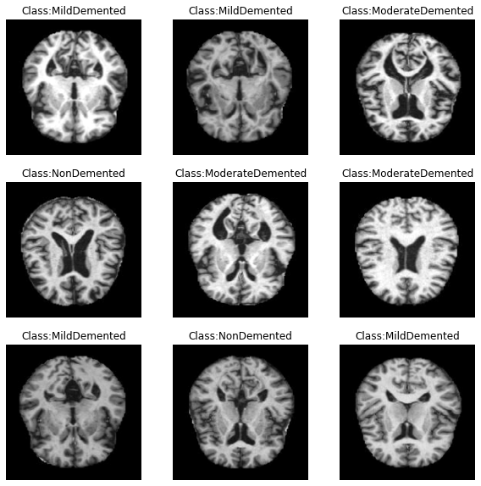
MATERİAL AND METHOD
DATASET DESCRIPTION
The datasets were obtained from the Kaggel Alzheimer's Dataset. The dataset comprises MRI images and is divided into four classes: Mild Demented, Moderate Demented, Non-Demented, and Very Mild Demented. Both the training and testing sets include images representing each severity level of Alzheimer's. The dataset is organized into two files: Training and Testing. Each file contains approximately 5000 images, resulting in a total dataset size of around 10,000 images.

Slide 6
MATERİAL AND METHOD
IMAGE PREPROCESSING
Resizing the images to a fixed size (176 x 176), normalizing the pixel values, and converting the images to tensors
DATA AUGMENTATION
By employing augmentation techniques and merging the augmented images sets up an image data generator with various augmentation techniques such as zooming, brightness adjustment, and horizontal flipping. It rescales the pixel values of the images and defines the data format for the generated image batches

Slide 7
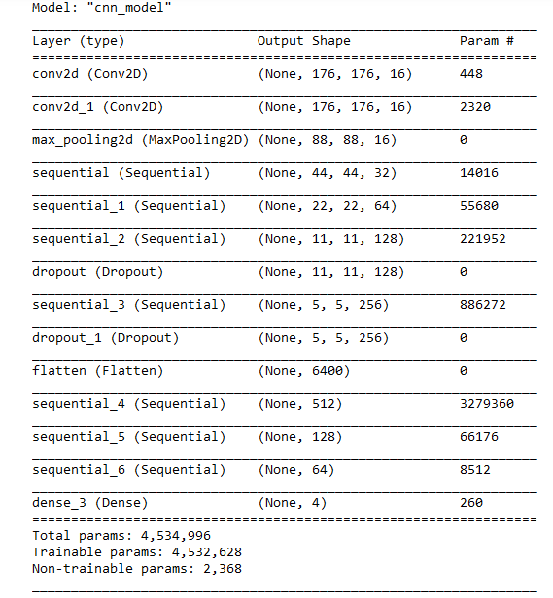
CONVOLUTİONAL NEURAL NETWORK (CNN)
The model has a total of 4,534,996 parameters, which are the learnable weights and biases.
These parameters are adjusted during the training process to optimize the model's performance.
Notes:
CNN is a deep learning architecture specifically designed for processing grid-like data, such as images.
It consists of multiple convolutional and pooling layers to capture hierarchical features.

Slide 8
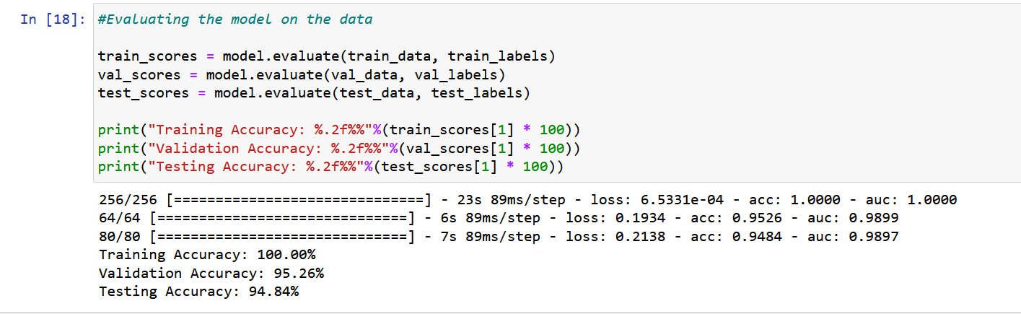
EVALUATİNG THE MODEL ON THE DATA
Notes:
Overall: The model achieved 100% accuracy on the training data, suggesting it successfully learned the training samples.
The validation accuracy is slightly lower than the training accuracy at 95.26%, indicating some level of generalization to unseen data.
The testing accuracy is slightly lower than the validation accuracy at 94.84%, further confirming the model's performance on new, independent samples.

Slide 9
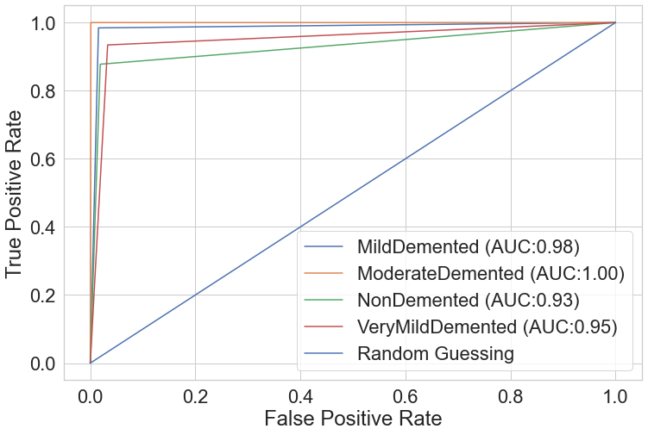
METRİCS FOR A CLASSİFİCATİON
support | f1-score | recall | precision
639 | 0.97 | 0.98 | 0.95 | NonDemented
635 | 1.00 | 1.00 | 1.00 | VeryMildDemented
662 | 0.91 | 0.88 | 0.94 | MildDemented
624 | 0.92 | 0.93 | 0.90 | ModerateDemented
 | Accuracy | Precision | Recall | F1 score
CNN | 95.26% | 95.11% | 95.96% | 95.62%
Notes:
The table provided contains summary metrics for a classification model's performance on different categories of dementia.
The categories are NonDemented, VeryMildDemented, MildDemented, and ModerateDemented.
These metrics provide an assessment of the model's performance for each category.
The F1-score is a measure that balances precision and recall, where higher values indicate better performance.
Recall represents the proportion of true positives correctly identified, while precision represents the proportion of true positives out of all predicted positives.
Based on the provided metrics, the model appears to perform well across the different categories, with high scores indicating good classification performance.
Comparing the metrics across the different dementia stages, we can observe that VeryMildDemented has the highest performance overall, with perfect scores in F1-score, recall, and precision. NonDemented also performs well in all metrics, while MildDemented and ModerateDemented show slightly lower scores. These comparative insights highlight the strengths and weaknesses of the model in correctly classifying different stages of dementia.

Slide 10
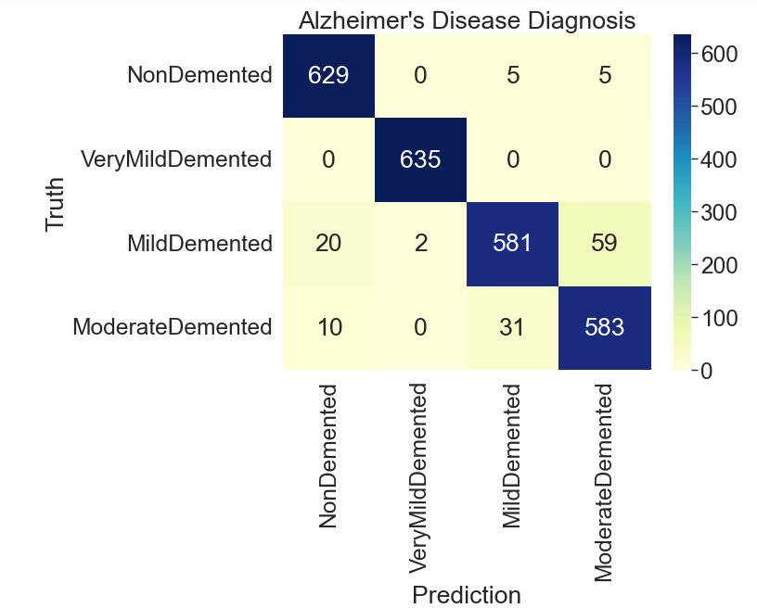
PERFORMANCE VALIDATION (CONFUSION MATRIX)
CNN

Slide 11
THANK YOU

